Slide 1
Structured Query Language
Dr. Sonal Dekhane
ITEC 3200

Slide 2
What is SQL?
NOT a complete programming language
Data sublanguage
Consists of:
Constructs/commands for defining and processing a database
Data Definition Language (DDL)
Data Manipulation Language (DML)
Developed by IBM Corporation in late 1970s
Tutorials:
http://beginner-sql-tutorial.com/sql.htm
http://www.w3schools.com/sql/default.asp
http://adbc.kennesaw.edu/

Slide 3
How to use SQL?
Requires only a text processor
Statements can be submitted interactively using a DBMS provided command prompt
Graphic tools available for many tasks, but not all
Statements must be embedded in scripting and programming languages

Slide 4
SQL DDL
Used to:
create and alter database structures such as tables

Slide 5
Create a table using SQL
Syntax:
CREATE TABLE NewTableName(
ColumnName DataType OptionalConstraint,
ColumnName DataType OptionalConstraint,
ColumnName DataType OptionalConstraint,
optional table constraints
….
);

Slide 6
SQL CREATE TABLE Statement
Syntax:
CREATE TABLE NewTableName(
ColumnName, DataType, OptionalConstraint,
ColumnName, DataType, OptionalConstraint,
ColumnName, DataType, OptionalConstraint,
optional table constraints
….
);
PRIMARY KEY, NOT NULL, NULL, UNIQUE

Slide 7
Example
CREATE TABLE DEPARTMENT(
DepartmentName Char(35) PRIMARY KEY,
BudgetCode Char(30) NOT NULL,
OfficeNumber Char(15) NOT NULL,
Phone Char(12) NOT NULL
);

Slide 8
Example of DEFAULT Keyword
CREATE TABLE EMPLOYEE(
EmployeeNumber Int PRIMARY KEY,
FirstName Varchar(25) NOT NULL,
LastName Varchar(25) NOT NULL,
Department Char(35) NOT NULL DEFAULT ‘Human Resources’,
Phone Char(12) NULL,
Email Char(16) NOT NULL UNIQUE
);

Slide 9
Example of DEFAULT Keyword
CREATE TABLE EMPLOYEE(
EmployeeNumber Int PRIMARY KEY,
FirstName Varchar(25) NOT NULL,
LastName Varchar(25) NOT NULL,
Department Char(35) NOT NULL DEFAULT ‘Human Resources’,
Phone Char(12) NULL,
Email Char(16) NOT NULL UNIQUE
);
Set initial values

Slide 10
Example of DEFAULT Keyword
CREATE TABLE EMPLOYEE(
EmployeeNumber Int PRIMARY KEY,
FirstName Varchar(25) NOT NULL,
LastName Varchar(25) NOT NULL,
Department Char(35) NOT NULL DEFAULT ‘Human Resources’,
Phone Char(12) NULL,
Email Char(16) NOT NULL UNIQUE
);
Variable length, maximum 25 characters
Extra processing is required
Fixed length, values smaller than 16 characters will be padded with blanks

Slide 11
Char vs. Varchar
Char
Varchar
Values smaller than specified length will be padded with blanks
No extra processing overhead
Use when all values are known to be of fixed length or close (e.g. SSN, phone, company email)
No padding involved, use what is needed
Extra 1 or 2 bytes are used to store length of the value, extra processing required
Use when values can vary to a great extent (e.g. first name, last name, personal email)

Slide 12
Decimal Data Type
Used for decimal values
Syntax
Decimal (x, y)
x indicates maximum number of digits allowed
y indicates number of decimal places
Example
Decimal (8, 2)
Up to 8 digits total
2 digits after decimal point
123.45, 123456.78, etc.

Slide 13
Writing SQL Statements
Install MySQL 5.8 Community Server Edition
Use instructions provided in PDF document on D2L
Using the installer is the easiest way
Create a password for the root account and note it down
Start -> All Programs -> MySQL -> MySQL Workbench

Slide 14
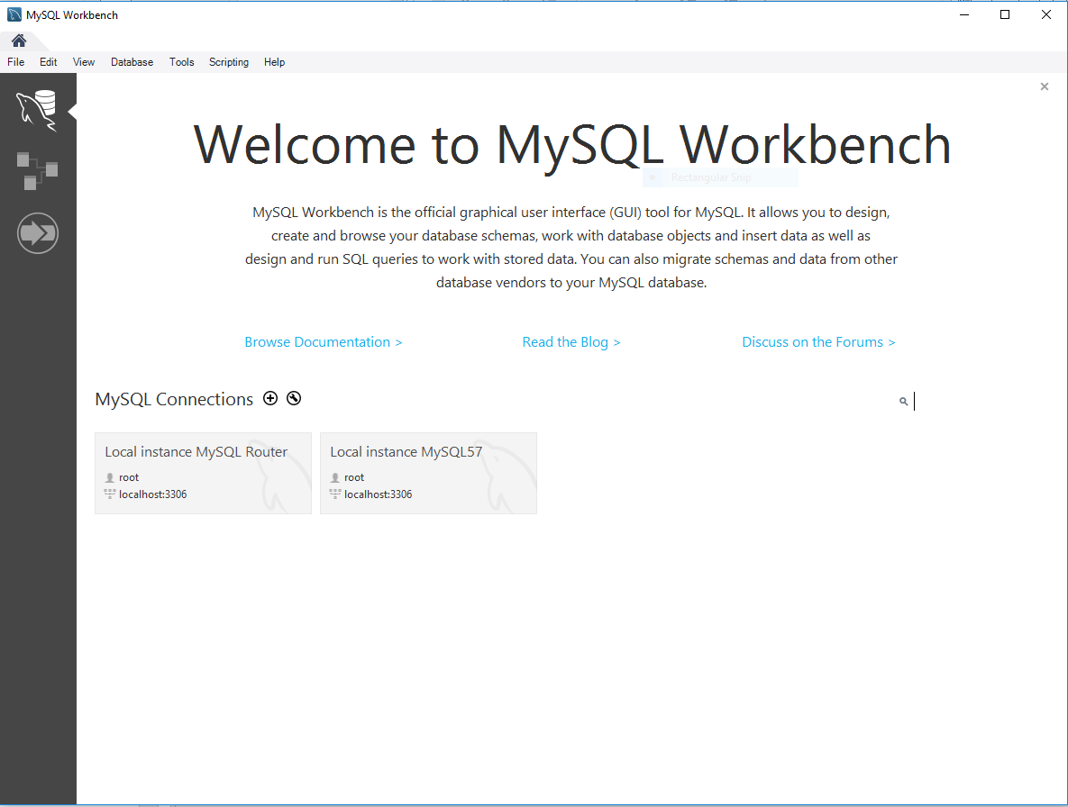
Workbench Home
Double-click Local Instance to start a new connection.
Enter username “root” and password created at installation

Slide 15
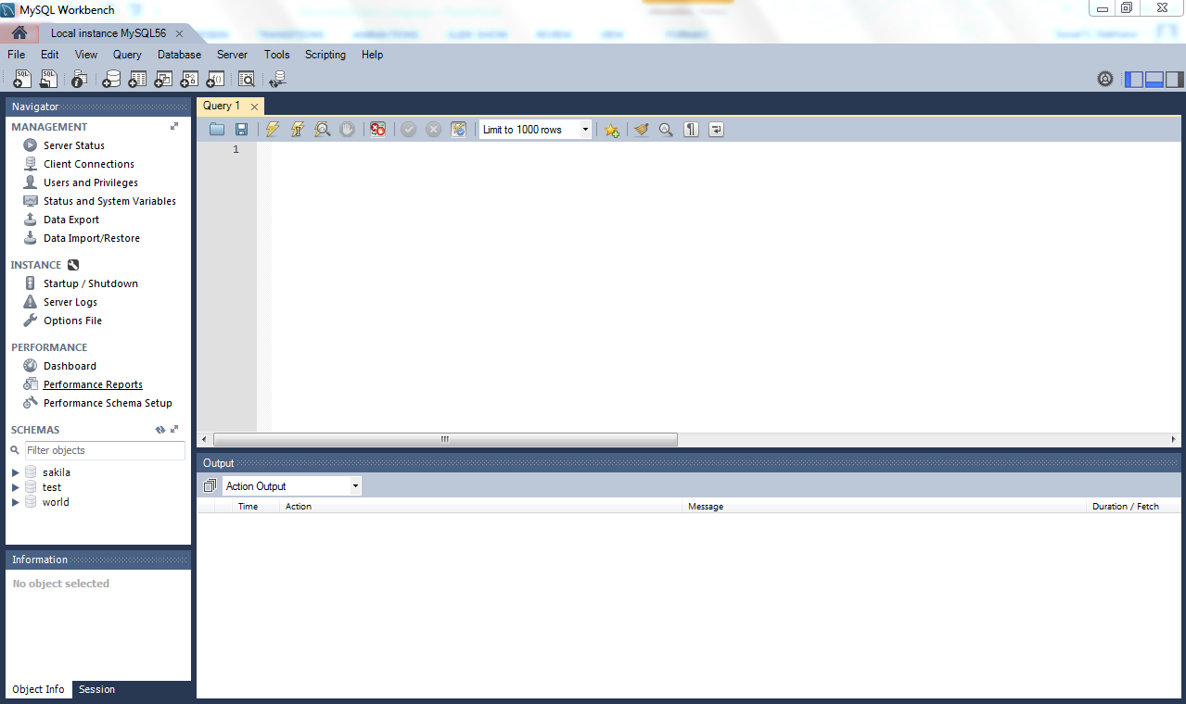
SQL Editor

Slide 16
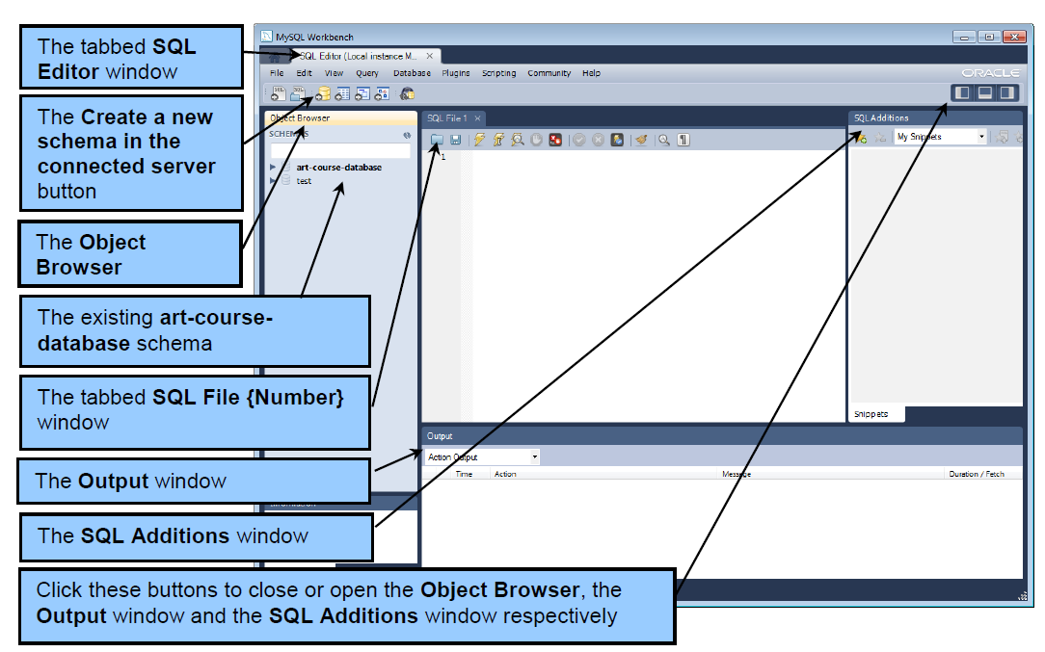
SQL Editor

Slide 17
Create a new database
Hide the SQL Additions Window
Click the “Create a new schema in the connected server” button
The name of the new schema/database is TestDB
If you don’t see the database in the object browser window, refresh the window
Right-click on the TestDB schema in the object browser and select “Set as default schema”
This makes it active and you can work with it

Slide 18
Create a table
Create tables DEPARTMENT and EMPLOYEE as shown in slides 7 and 8.
Make sure the tables are created in the correct database

